Slide 1
Data sharing and Backup
We will be using an electronic whiteboard (Etherpad).
Please log onto your computer and access: https://public.etherpad-mozilla.org/p/2019-2-26-cruk-ci-myrd
Anne Pajon
26th February 2019
This work is licensed under a Creative Commons Attribution 4.0 International License.

Slide 2
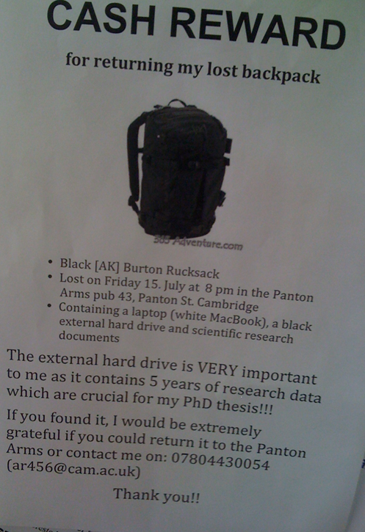
To avoid data disasters ... What would you do if you’d lose your data tomorrow?
xxxxxxxxxxx
xxxxxxxxxxxxx
https://blogs.ch.cam.ac.uk/pmr/2011/08/01/why-you-need-a-data-management-plan/

Slide 3
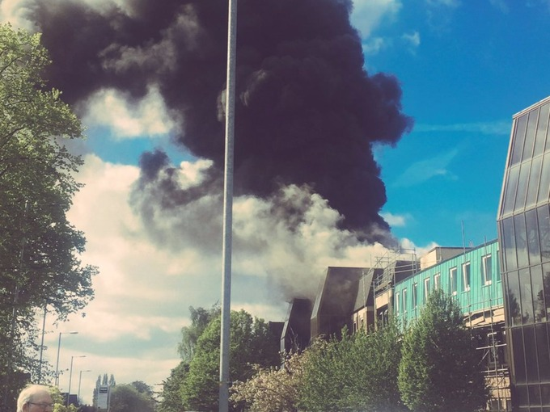
What if?
Cancer Research UK – University of Manchester – 27 April 2017
Notes:
Why file organization of your research data is important
Specific techniques for organizing your research data,
including developing plans for:
– File structures - where to put data so you won’t lose it
(including tips on embedding metadata)
– File naming - what to call data so you know what it is
– A bit on version control - keeping track of data
• Will also include opportunities for:
– Small group discussion
– Exercise for organizing your own data
• Focuses on research data, but applies to other types of files as well

Slide 4

What would you do if you’d lose your data tomorrow?
Your laptop got stolen
Your office/house burnt
Your USB stick is lost
Your portable hard disk is damaged
Your data in Dropbox disappeared
https://en.wikipedia.org/wiki/The_Scream
Notes:
Why file organization of your research data is important
Specific techniques for organizing your research data,
including developing plans for:
– File structures - where to put data so you won’t lose it
(including tips on embedding metadata)
– File naming - what to call data so you know what it is
– A bit on version control - keeping track of data
• Will also include opportunities for:
– Small group discussion
– Exercise for organizing your own data
• Focuses on research data, but applies to other types of files as well

Slide 5
Never work directly on the raw data
Leave it intact
Always make a copy, and work on the copy

Slide 6
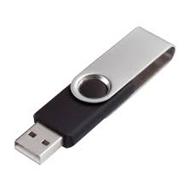
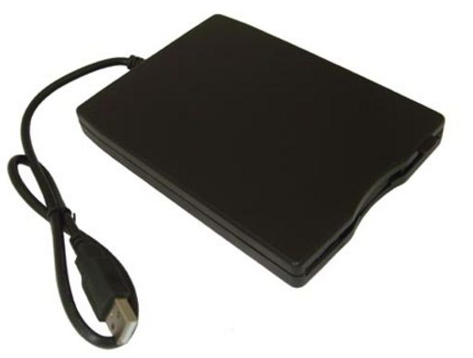

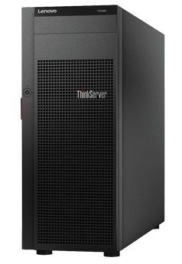




Data backup
At least 2 backups at 2 different locations
External disks
Online backup
Servers
Department
College
IT
Cheap
£10-15 / TB (1024GB)
Accessibility
Free (limit)
Managed by experts
Failure rate
1.5%/year
Personal data
Hacking
Moving between institutions

Slide 7

Data backup
Manual
Automated
- Install software
e.g. Time machine (Mac users)
Copying files to relevant folders
- RAID technology
- Checksums
Automatically upload files to the cloud when any changes are saved
Copying files to relevant folders

Slide 8



If manual … how often?
How much would you be willing to lose?
1 day
1 week
1 month-year
Software allows you to set up backup time
automatically

Slide 9
Data backup and file sharing
Space/price
2 GB (free)
Unlimited (£55/year)
15 GB (free)
1 TB (~£80/year)
1 TB (free)
File history and recovery
Yes, unlimited
Yes
Last 90 days
File size limit
None
5 GB
15 GB
Support
UIS
UIS
UIS
OS
Windows, Mac, Linux,
Android, iOS
Windows, Mac,
Android, iOS
Windows, Mac,
Android, iOS
Accessibility
Sync anywhere on any devices
Live editing
Integration with Microsoft Office

Slide 10
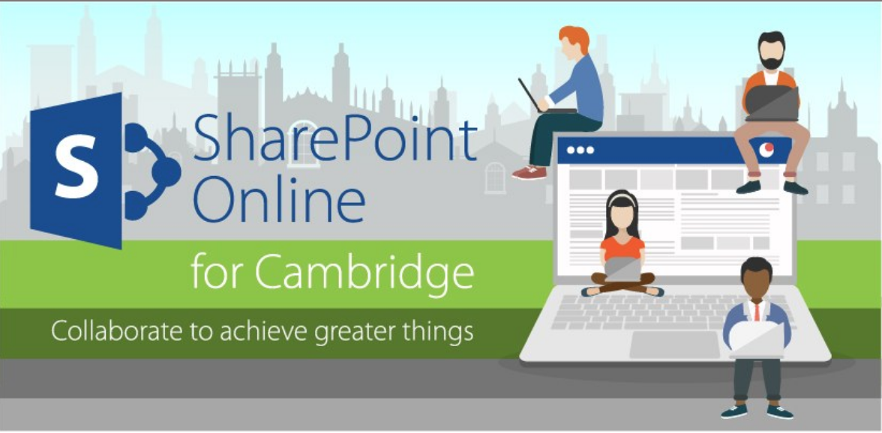

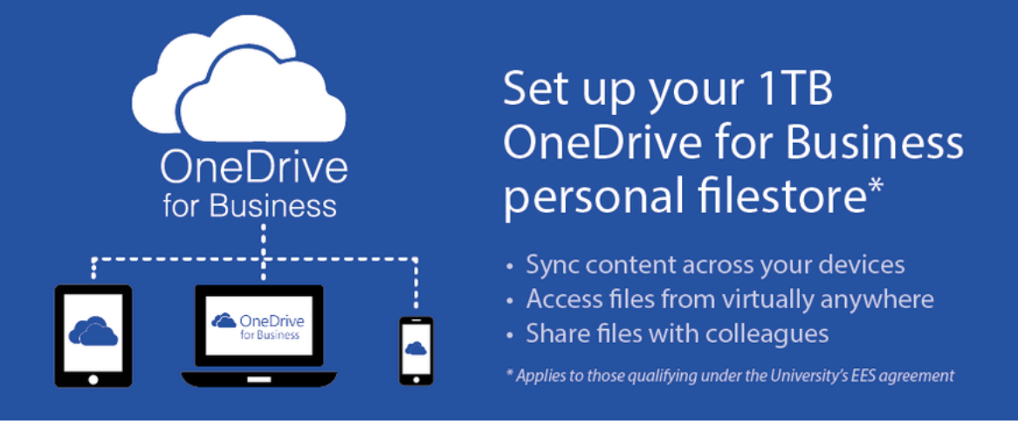



More … file sharing
Email
Website
FTP

Slide 11
Beware of the cloud

Slide 12
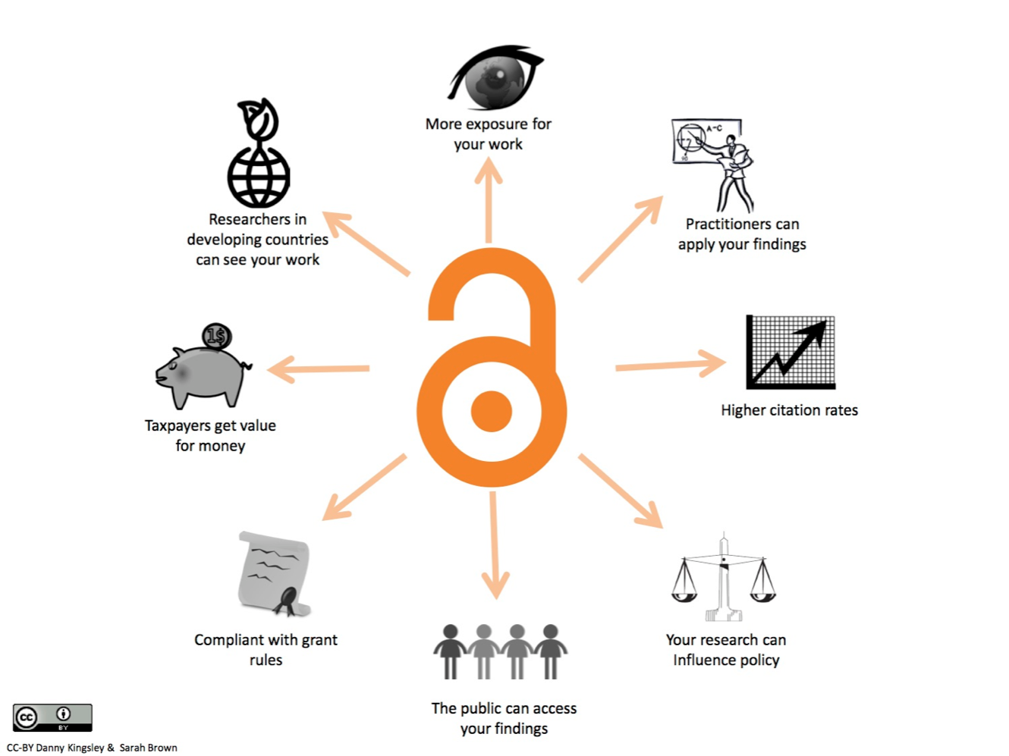
Why data sharing is important?

Slide 13
What data to share?
papers
results and figures
processed data
raw data and associated metadata
methods used
software and scripts

Slide 14
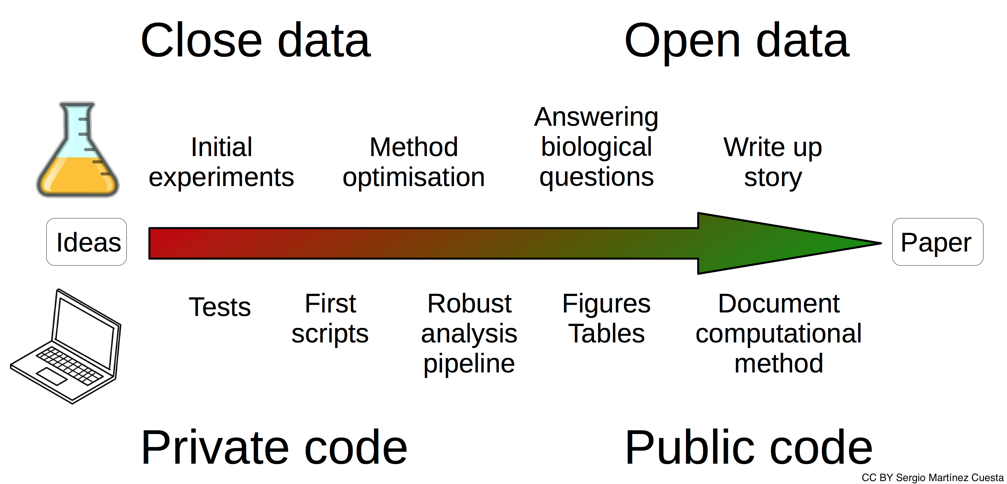
When to share?

Slide 16
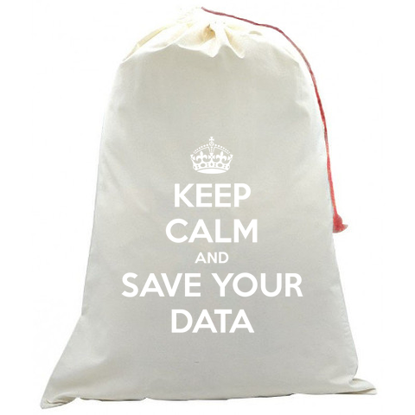
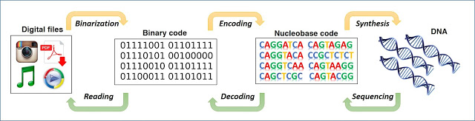
The everlasting external disks
Are they really permanent? What if…
Notes:
Why file organization of your research data is important
Specific techniques for organizing your research data,
including developing plans for:
– File structures - where to put data so you won’t lose it
(including tips on embedding metadata)
– File naming - what to call data so you know what it is
– A bit on version control - keeping track of data
• Will also include opportunities for:
– Small group discussion
– Exercise for organizing your own data
• Focuses on research data, but applies to other types of files as well

Slide 17
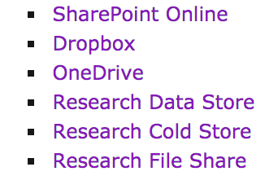
Storage + Security + Encryption + Backup + Sharing
University Storage Service
CRUK CI IT
Lab
Individual (Time machine)
CLOUD?
Notes:
Why file organization of your research data is important
Specific techniques for organizing your research data,
including developing plans for:
– File structures - where to put data so you won’t lose it
(including tips on embedding metadata)
– File naming - what to call data so you know what it is
– A bit on version control - keeping track of data
• Will also include opportunities for:
– Small group discussion
– Exercise for organizing your own data
• Focuses on research data, but applies to other types of files as well

